Slide 1
Research Methodology and IPR
Course Teacher
Dr. Basavaraj S.Kudachimath

Slide 2
Course Outline

Slide 3
Course Learning objectives:
To understand the basic components of research design
To Gain an insight into the applications of research methods
To equip students with various research analytical tools used in business research
To provide the insights of IPR and IPR system in India

Slide 4

Unit-1
Introduction to Business Research:
Presentation by
Dr. Basavaraj S.Kudachimath

Slide 5
Discussion Points
Meaning of Business Research
Types of Business Research
Process of research-
  Defining the research problem,
  Formulating the research Hypothesis,
  Developing the research proposals,
  Research design formulation,
  Management problem,
  Sampling design,
  Planning and collecting the data for research,
  Data analysis and interpretation.
Research Application in business decisions,
Ethical issues in business research.
Features of a good research study.

Slide 6

What is research?
Research is a process of investigation. An examination of a subject from different points of view. It’s not just a trip to the library to pick up a stack of materials, or picking the first five hits from a computer search.
Research is a hunt for the truth. It is getting to know a subject by reading up on it, reflecting, playing with the ideas, choosing the areas that interest you and following up on them.
Research is the way you educate yourself.

Slide 7

What is Research?
Webster's New International Dictionary defined research as, ‘careful or critical inquiry or examination in seeking facts or principles; diligent investigation in order to ascertain something.‘
According to Clifford Woody ‘Research comprises defining and redefining problems, formulating hypothesis or suggested solutions; collecting, organising and evaluating data; making deductions and reaching conclusions; and at last carefully testing the conclusions to determine whether they fit the formulating hypothesis.
D. Slessinger and M. Stephenson in the Encyclopedia of Social Sciences define research as ' the manipulation of things, concepts or symbols for the purpose of generalizing to extend, correct or verify knowledge, whether that knowledge aids in construction of theory or in the practice of an art.

Slide 8
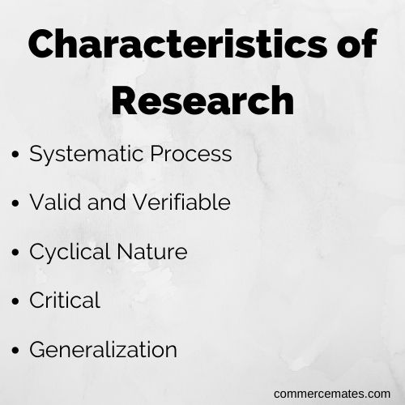
Therefore, research could be understood as an organized activity with specific focus [objectives] on a problem or issue supported by compilation of related data and facts, involving application of relevant tools of analysis and deriving logically sound inferences based on originality.
Research, at its core, is a systematic and careful investigation into a subject of study to discover new facts or information.

Slide 9

How Business Research defined?
According to McDaniel and Gates :
"Business research is the planning, collection and analysis of data relevant to business decision-making and the communication of the results of this analysis to management".
According to Zikmund :
"Business research is a management tool that companies use to reduce uncertainty. It is a manager's source of information about organizational and environmental conditions and covers topics ranging from long range planning to the most ephemeral tactical decisions".

Slide 10
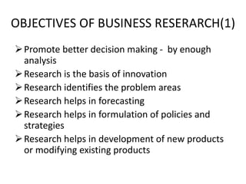

Slide 11
Motivation in Research
Desire to get research degree along with its simultaneous benefits.
Desire to solve the challenging and unsolved problems.
Joy of doing some creative work.
Desire to give service to society.
Desire to get respectability.

Slide 12
Importance of Business Research
Business Research helps to solve the Business problem
Business Research provides various data for Business decision making
Helps to study the business phenomena
Govt. needs research reports for planning and execution
Research is needed to develop the existing body of knowledge.
Research is needed for developing the society in general.

Slide 13
Types of Business Research
1.Descriptive Research. ( A research which describes the problem. What? and How?)
2.Applied Research. ( A research conducted in an organization to find the solution for the problem. (How to solve problem))
3. Fundamental Research. ( Research conducted to generalize the phenomena or the tendency (Is it applicable everywhere?)
4. Quantitative research. ( Research conducted for variables expressed in terms of quantity)
5. Qualitative research. ( Research conducted for variables expressed in terms of quality. (How many?)
6. Conceptual Research. ( Research conducted on certain theory or concept)

Slide 14
Types of Research continued
7. Empirical Research. ( Research conducted on experiments)
8. Historical Research. ( Research conducted on historical or past data)
9. Case study research. ( Research conducted on a single unit)
10. Scientific Research. ( Research conducted in the field of science)
11. Social Research. ( Research conducted in the field of social behaviors)

Slide 15
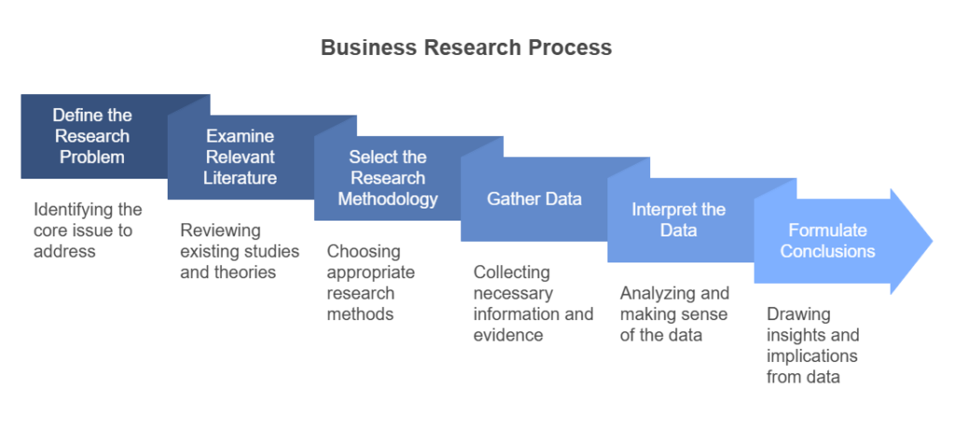
Research Process

Slide 16
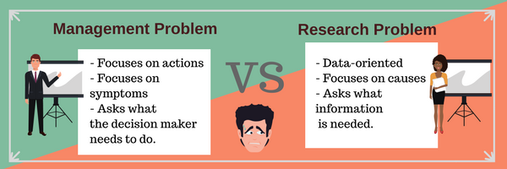
Management Vs Research Problem

Slide 17
1. Defining the Problem
Defining the problem refers to expressing an exact problem statement. In business, management problem has to be redefined as research problem which helps to frame the research work.
Example: Management Problem: Increasing the sales of the company.
Research problem is : Analysing the consumers buying behaviour towards the product in the market.

Slide 18
2. Review of Literature
A literature review is a comprehensive survey, synthesis, and critical evaluation of existing scholarly research on a specific topic. It maps out current knowledge, identifies key researchers, highlights gaps or contradictions in studies, and provides a theoretical foundation for new research
Key Aspects of a Literature Review:
Content: It covers scholarly articles, books, dissertations, and relevant reports.
Structure: It is organized by themes, trends, or methodologies rather than just a chronological list of summaries.
Critical Analysis: It does not just summarize; it evaluates and compares sources to explain how they relate to the research topic
Purpose: To demonstrate familiarity with the field, establish credibility, avoid duplicating previous work, and justify your research question.

Slide 19
Steps to Conduct a Literature Review:
Search for relevant literature.
Evaluate and select relevant sources.
Identify themes, debates, and gaps.
Outline the structure of your review.
Write the review, synthesizing the information

Slide 20
3. Select Appropriate Research Methodology
Research methods are systematic techniques used to collect and analyze data, generally categorized into quantitative (numerical), qualitative (descriptive), and mixed-methods. Key techniques include surveys for broad data, interviews and focus groups for in-depth insights, observations, and experiments for cause-and-effect relationships.

Slide 21
4. Collecting the data
A data gathering procedure is a systematic, step-by-step plan for collecting accurate, relevant information to answer research questions. It involves defining research objectives, selecting appropriate qualitative or quantitative methods (e.g., surveys, interviews, observations), creating instruments, sampling, gathering data ethically, and organizing data for analysis

Slide 22
5. Interpreting the Data
Data interpretation in research is the process of reviewing, analyzing, and assigning meaning to collected information (qualitative or quantitative) to draw conclusions, identify patterns, and answer research questions. It transforms raw data into actionable insights, bridging the gap between findings and informed, evidence-based decisions or theories.

Slide 23
6. Formulating conclusions.
Based on the analysis the researcher come to a conlusion and either re form his research or arrive at the decision

Slide 24
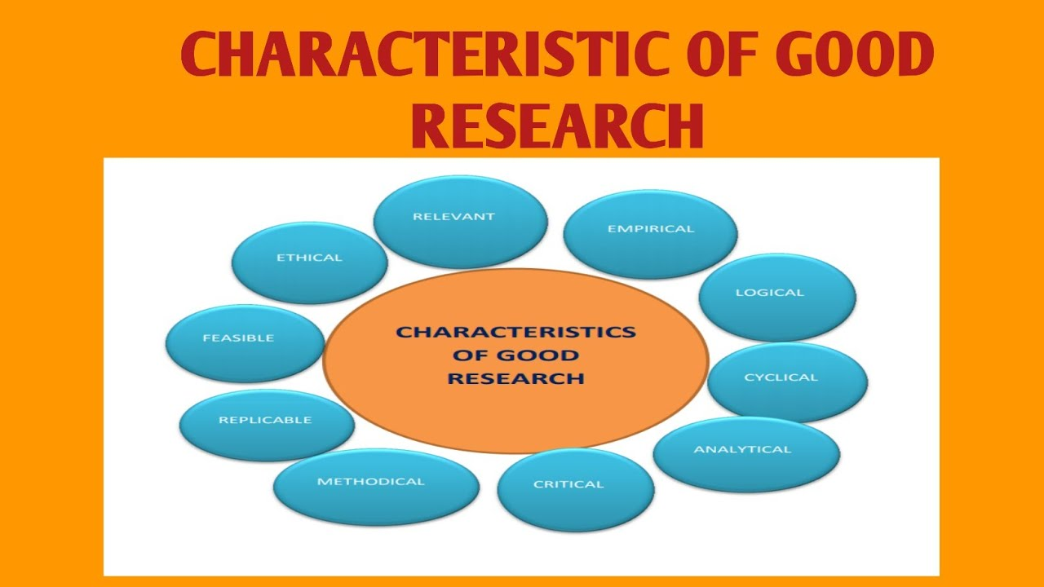

Slide 25

Hypothesis in Research

Slide 26
1. Meaning of Hypothesis
A hypothesis is a tentative statement predicting the relationship between two or more variables.
Example:
“Higher customer trust increases digital loan adoption.”

Slide 27
Types of Hypothesis
A. Null Hypothesis (H₀): No relationship/effect exists.
Example: Interest rate does not affect demand.
B. Alternative Hypothesis (H₁) Relationship/effect exists.
Example: Interest rate affects demand.
C. Simple Hypothesis: One independent and one dependent variable.
Example: Price affects sales.
D. Complex Hypothesis: Multiple variables involved.
Example: Price, quality, and promotion affect sales.
E. Directional Hypothesis: Specifies direction.
Example: Lower price increases demand.
F. Non-directional Hypothesis: Only states relationship exists.
Example: Price is related to demand.

Slide 28
Steps to Form a Good Hypothesis
Identify research problem
Review literature
Identify variables
Establish expected relationship
Make clear and testable statement
Ensure measurable data availability

Slide 29
Characteristics of Good Hypothesis
Clear
Specific
Testable
Logical
Based on theory
Relevant to objectives

Slide 30
Ethical Issues in Research

Slide 31
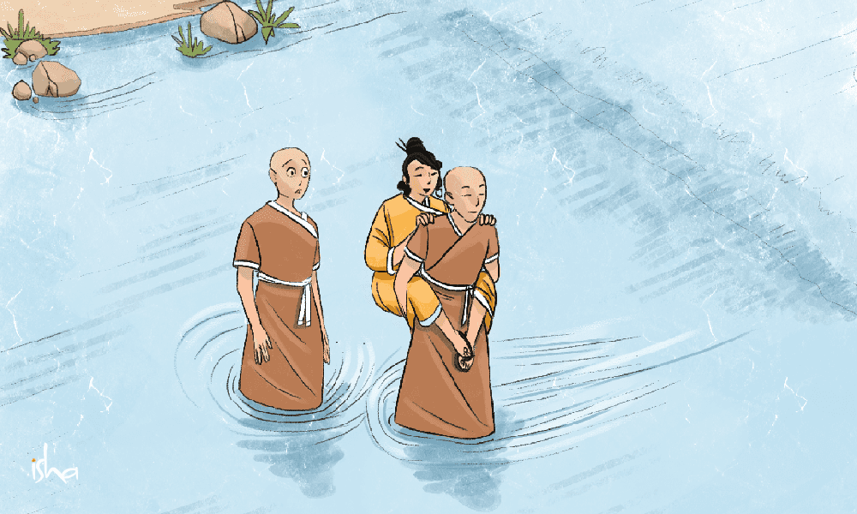
What is ethics?
Ethics refers to the philosophical study of moral principles—concepts of right/wrong, good/bad, and virtue—that guide human conduct. It goes beyond law or personal feelings to provide justified, consistent standards (e.g., honesty, fairness, non-maleficence) used to make principled decisions.
Key Aspects of Ethics
Rational Framework: Ethics is not just following rules blindly; it is using reasoning to evaluate why an action is right or wrong.
Subject Matter: It focuses on voluntary human actions (choices) that have moral implications, not involuntary behaviors (e.g., sneezing).
Components: Ethics includes core virtues like compassion, loyalty, and integrity

Slide 32

What Are Ethical Issues in Business Research?
Moral Conflicts
Dual Responsibility
Situations where research actions contradict established moral principles or societal values.
Both individuals and organizations bear ethical obligations in research conduct.
Potential Consequences
Regulatory penalties, damaged reputation, and stakeholder backlash from ethical breaches.

Slide 33








Key Ethical Principles in Business Research
Informed Consent
Full disclosure and voluntary participation
Privacy & Confidentiality
Protecting participant data and identities
Truthfulness
Honest representation of methods and findings
Non-maleficence
Preventing harm to participants

Slide 34








Stakeholders and Their Rights
Respondents
Researchers
Data privacy protection
Professional standards
Accurate study information
Methodological integrity
Right to withdraw
Objective analysis
Society
Sponsors/Clients
Beneficial outcomes
Unbiased findings
Truth in reporting
Resource accountability
Responsible innovation
Contractual transparency

Slide 35





Common Unethical Practices
Confidentiality Breaches
Sharing identifiable participant data without permission or proper anonymization.
Data Falsification
Inventing, altering, or selectively reporting research findings to support desired outcomes.
Misrepresentation
Distorting research conclusions to satisfy corporate agendas or personal interests.
Procedural Violations
Bypassing required ethical reviews or conducting research without proper approvals.

Slide 36

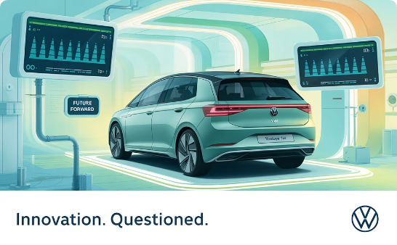

Real-World Examples of Ethical Dilemmas
Customer Data Misuse
Volkswagen Emissions Scandal
Privacy Violations
Market research firm repurposed confidential customer survey responses for secondary analysis without consent.
Consumer research company failed to anonymize sensitive participant data before sharing with third parties.
Researchers deliberately falsified emissions test data to show compliance with environmental regulations.

Slide 37





Managing and Preventing Ethical Issues
Ethics Policies
Develop clear organizational codes and guidelines for research conduct.
Training
Educate researchers on ethical principles and real-world application.
Monitoring
Implement review boards and regular compliance audits.
Reporting Systems
Create safe channels for reporting ethical concerns without fear.

Slide 38

Conclusion: The Path Forward
Reinforce Ethics as Core Value
Prioritize integrity over expedience. Ethical research builds lasting credibility and trust.
Commit Organizationally
Dedicate resources to ethical oversight. Make ethical standards part of performance evaluation.
Foster Ethical Culture
Celebrate ethical choices. Create environments where integrity is rewarded over shortcuts.

Slide 39
THANK YOU

